Slide 1

ACNC Financial Reporting
Missions Interlink Conference
17 July 2013

Slide 2
Session overview
ACNC -- financial reporting obligations
  Legislation and regulations (S 60 ACNC)
  Small, medium, large and basic religious charities
  Revenue
  Applicable financial reporting framework
    Australian Accounting Standards
      General-purpose financial reports
      Special purpose financial reports
  Audit or Review
  Reporting timelines
Notes:
ACNC Bill
Section 60 – Reporting
This section covers the requirements for
the annual information statement for small, medium and large registered entities
Audit and review requirements for medium and large entities
Requirements for an audit or review
Requirement for and auditors all reviewers independence declaration
Requirement that registered entities must provide access to books and all necessary assistance
The Application of this section to basic religious charities
The treatment of errors in information statements in financial reports
Additional reporting requirements
Substituted accounting periods
Collective and joint reporting

Slide 3
What does it mean for you?
“These are the most important reforms to the sector in 100 years...”
Senator Arbib
Notes:
In this year’s Budget, the Government announced three reforms to ensure the sustainability of the NFP sector and improve its effectiveness: the better targeting of not-for-profit tax concessions, the ACNC, and the introduction of a statutory definition of ‘charity’. - Newsletter 1
The Government directly supports not-for-profits through grants and service funding and indirectly through a variety of tax concessions. Funding for the sector through tax concessions comes at a cost to the budget bottom line - quantifiable tax expenditures in 2010-11 are estimated to be $3.3 billion, but this does not include unquantifiable expenditures including forgone income tax which is estimated to be at least $1 billion per year but could be significantly more.
Timelines
Introducing a statutory definition of ‘charity’: consultation paper — expected October 2011
• Second exposure draft of ‘In-Australia’ special conditions and definition of not-for-profit: expected – expected late 2011
• Better targeting of tax concessions: exposure draft — expected late 2011
• A national approach to fundraising regulation: discussion paper — expected late 2011
• Legislation to establish the ACNC: exposure draft — expected late 2011
• Review of corporations limited by guarantee and governance arrangements for NFPs: late 2011
• Introducing a statutory definition of ‘charity’: exposure draft legislation— first half of 2012

Slide 4


ACNC and Reforms
Notes:
Everyone will have their own opinion on whether the reforms are good for their organisation
Some may also hold a position on whether the regulation is good for the Australian community and sector as a whole.
But we need to ensure that we move past our own moral position and focus on ensuring compliance with the law (as it is or expect to be)

Slide 5
Current Changes...
Charity Sector
ACNC
Definition of Charity
Commercial Activities
Accounting standards
State based Acts
ATO Rulings
Fund raising
Audit Requirements
In Australia
Managing Funds
Government Funding requirements
Case Law
ASIC requirements
Employment Law
Notes:
So let's have a look at the types of changes impact on the charity sector at the moment

Slide 6
The Coalition Position (May 2013)
Return responsibility to ATO and ASIC
Independent body
Education and support
Information to assist registration (ATO)
One stop shop for information
Advocate for rights of NFP’s
Represent interests to Govt
Facilitate interaction with Govt
Research and cross sector evaluation on issues of concern
Foster innovation
Notes:
On 27 May, Kevin Andrews in a speech to parliament outlined the coalitions position on a regulator within the framework of "a civil society"
The coalition's proposed not-for-profit regulator can be summarised into 10 points

Slide 7
Current Changes...
Charity Sector
ACNC
Definition of Charity
Commercial Activities
Accounting standards
State based Acts
ATO Rulings
Fund raising
Audit Requirements
In Australia
Managing Funds
Government Funding requirements
Case Law
ASIC requirements
Employment Law
Notes:
Don't rely on the potential changes government to avoid acting on the current law!
It would be very easy for me to stand here and tell you how hard the change is going to be.
There are going to be difficulties and complexities that these are not excuses for inaction

Slide 8
ACNC – So What....?
Governance
Expertise
Management
Skills
Stakeholders
Empowered
Advisors
Structure
Processes
Change management
Communication
Benchmarking
Communicating
Changing
Responsibilities
Controls
Accountability
Lawyers
Accountants
Auditors

Slide 9
Structure of Legislation
ACNC Act
Division 40 Online Portal
Legislation
(3 Dec 2013)
Divisions
Regulations
(1 July 2013)
Division 45 Governance Standards
Division 55 Record Keeping
Division 50 External Governance Standards
YES
YES
NO
Division 60 Reporting
YES

Slide 10
Structure of Legislation
ACNC Act
Division 40 Online Portal
Legislation
(3 Dec 2013)
Divisions
Regulations
(1 July 2013)
Division 45 Governance Standards
Division 55 Record Keeping
Division 50 External Governance Standards
YES
YES
NO
Division 60 Reporting
YES

Slide 11

ACNC Financial Reporting Overview
ACNC Bill – Division 60 – Reporting
  Annual Information Statements
  (Sub Div 60 B)
      Required for all registered entities
      To be lodged within six months of the end of the financial year
  Annual Financial Reports
  (Sub Div 60 C)
      Required for certain entities
      To be lodged within six months of the end of the financial year

Slide 12
ACNC Reporting Summary

Slide 13
ACNC Reporting Summary
?

Slide 14
ACNC Reporting Summary
?

Slide 15
Basic Religious Charity Exemption
Exemption from financial statement lodgement for “basic religious charities”
  Sole purpose must be advancement of religion
  Companies and incorporated associations not exempt
  Other exclusions
  Need to lodge Annual Information Statement
Self-assess
  Notify ACNC in Annual Information Statement

Slide 16
Basic Religious Charity
What is a 'basic religious charity'? (s 205-35)
  A basic religious charity is a registered charity that meets all of the following requirements:
  it is registered for a purpose that is the advancement of religion
  it could not be registered as any other subtype of charity
  it is not a body corporate registered under the Corporations Act 2001, an Indigenous corporation (under the Corporations (Aboriginal and Torres Strait Islander) Act 2006), a corporation registered under the Companies Act 1985 of Norfolk Island, or an incorporated association in any state or territory
  it is not endorsed as a deductible gift recipient (DGR) itself (however it can be endorsed to operate DGR funds, institutions or authorities as long as their total revenue is less than $250,000 for the particular financial year)
  the ACNC has not allowed it to report as part of a group, and
  it has not received more than $100,000 in government grants in the current financial year or either of the previous two financial years (2012 or 2011).

Slide 17
ACNC Reporting Summary
Notes:
Be careful of S 60-60 (2)

Slide 18
ACNC Reporting Summary
?

Slide 19
Classification of entities
Section 205 – 25
The ACNC Act defines charity size according to annual revenue:
  Small charity – annual revenue is less than $250,000
  Medium charity – annual revenue is $250,000 or more but less than $1 million
  Large charity – annual revenue is $1 million or more.

Slide 20

Revenue - The Key
Section 205 – 25 (4)
Revenue to be calculated in accordance with accounting standards (even if the standard does not otherwise apply)
Notes:
Section 205 – 25
Just one criteria - Revenue
Not an asset test
Not an employee test
No DGR Test
AASB 10 Consolidated financial statements
The objective of this Standard is to establish principles for the presentation and preparation of consolidated financial statements when an entity controls one or more other entities.
AASB 27 Separate Financial Statements
The objective of this Standard is to prescribe the accounting and disclosure requirements for investments in subsidiaries, joint ventures and associates when an entity prepares separate financial statements.

Slide 21
Revenue
Revenue recognition
For profit entities
Government grants
Construction contracts
Not-for-profit entities
Reciprocal transfer
AASB 120
AASB 111
Other Revenue
AASB 118
Non-reciprocal transfer
Construction contracts
AASB 111
AASB 118
Other Revenue
A ASB 1004

Slide 22
Whose revenue - Consolidation ???
AASB 10 Consolidated financial statements
  The objective of this Standard is to establish principles for the presentation and preparation of consolidated financial statements when an entity controls one or more other entities.
  Application NFP 1 Jan 20014
ED328 Consolidated financial statements
  Australian Implementation guidance for not for profit entities
AASB 27 Separate Financial Statements
  The objective of this Standard is to prescribe the accounting and disclosure requirements for investments in subsidiaries, joint ventures and associates when an entity prepares separate financial statements.
Notes:
ED 238 Consolidated financial statements – Australian Implementation guidance for not for profit entities
Accounting in the not-for-profit sector and for-profit sector should be the same, with transactional neutrality. AAS10 is designed for NFPs to adopt a neutral sector approach. The standard applies to for-profits from January 2013 and NFPs from January 2014, with the alternative of early adoption.
The exposure draft introduces a new definition of control. The new definition acknowledges a broader range of benefits derived from control, including “furthering their objectives” which fits better with NFPs.
In the exercise of power, a distinction is made between substantive and protective rights. For example, state governments can abolish a local government. But when they replace them, are controlling the council or protecting the ratepayers? Universities pose a similar control identity dilemma.

Slide 23
What is revenue?
Revenue is one part of income
‘revenue’ means the ‘gross inflow of economic benefits during the period arising in the course of the ordinary activities of an entity when those inflows result in increases in equity, other than increases relating to contributions from equity participants’ (AASB 118 Revenue, Definitions paragraph 7).
Notes:
This definition of revenue is different from the definition of income, as follows:
‘income’ means increases in economic benefits during the reporting period in the form of inflows or enhancements of assets or decreases of liabilities that result in increases in equity, other than those relating to contributions from equity participants.
Income encompasses both revenue and gains’ (Framework for the Preparation and Presentation of Financial Statements, paragraphs 70 and 74 and referred to in AASB 118 Revenue, Objective).
‘revenue’ means the ‘gross inflow of economic benefits during the period arising in the course of the ordinary activities of an entity when those inflows result in increases in equity, other than increases relating to contributions from equity participants’ (AASB 118 Revenue, Definitions paragraph 7).

Slide 24
Revenue includes...
The following are examples of inflows that are likely to be revenue:
  government and other grants
  donations
  fundraising activities
  bequests or legacies
  fees and charges for provision of services
  sales of goods
  interest earned, and
  dividends or similar distributions.

Slide 25
What does revenue not include?
Amounts collected for others
  Under the AASB standards, ‘amounts collected on behalf of third parties’ are not revenue. This can include:
    any sales taxes, goods and services taxes and value added taxes
    any amounts collected by your charity acting as an agent on behalf of another person or organisation (the ‘principal’) (AASB 118 Revenue, paragraph 8).
Income that is not revenue
  The following are gains that would not be revenue (Framework for the Preparation and Presentation of Financial Statements, paragraphs 75 and 76):
    gains from the sale of ‘non-current’ assets, such as property, plant or equipment
    unrealised gains, for example on the revaluation of certain assets.
Notes:
(Framework for the Preparation and Presentation of Financial Statements, paragraphs 75 and 76)

Slide 26
ACNC Reporting Summary
Notes:
Coy Limited by guarantee Section 45 B
DGR??

Slide 27
ACNC Reporting Summary
Notes:
Section 60 – Reporting
60-10 Medium and large registered entities must give annual financial reports
A medium registered entity or a large registered entity must give the Commissioner a financial report for a financial year, together with any auditor’s report or reviewer’s report
Within six months of the end of the financial year (or other such time as the Commissioner allows)

Slide 28
ACNC Reporting Summary

Slide 29
ACNC Reporting Summary

Slide 30
Legislative requirements
Division 60 – Reporting
60-15 Requirements for annual financial reports
  The financial report must comply with the requirements set out in the regulations

Slide 31

Legislative requirements
We now have regulations !!!:
  Financial report consists of (S 60.5):
    Financial statements
    Notes to the financial statements
    Responsible entities declaration

Slide 32
Legislative requirements
We now have regulations !!!:
  Financial Statements and Notes (S 60.10)
    “Financial statements” required by the accounting standards
    Notes required by the accounting standards
    Any other notes necessary to give a true and fair view of the financial position and performance
    Must give a true and fair view of the financial position and performance
    Must comply with accounting standards, except...
    Acknowledges reporting entity concept!

Slide 33
Financial statements
  “Financial statements” required by the accounting standards
    Statement of financial position
    Statement of profit and loss and other comprehensive income for the period
    Statement of changes in equity for the period
    Statement of cash flows for the period

Slide 34

Legislative requirements
We now have regulations !!!:
  Responsible entities declaration (S 60.15):
    Financial statements comply
    Pay debts as and when they fall due
    Signed by a responsible entity that is authorised

Slide 35

Legislative requirements
We now have regulations !!!:
  Special Purpose financial reports (S 60.30):
    Statement of Accounting Concept 1 (SAC 1)
    Reporting entity concept
    Determine the needs of the users

Slide 36
Compulsory Standards
  These standards are:
    AASB 101: Presentation of Financial Statements,
    AASB 107: Statement of Cash Flows,
    AASB 108: Accounting Policies, Changes in Accounting Estimates and Errors,
    AASB 1031: Materiality
    AASB 1048: Interpretation of Standards
    AASB 1054: Australian Additional Disclosures
  Unless the Commissioner allows the registered entity not to comply

Slide 37
Transitional Rules (S 60.40)
Registered entity that:
  Was not required to prepare a financial report that complied with accounting standards for:
    Financial year 2012–2013
    SAP commenced during 2012–2013 financial year
  2013-2014 - Medium
    Basic income and expenditure
    Basic assets, liabilities and net assets
  2013-2014 - Large
    Per above plus interest exp, Non current loans receivable and payable

Slide 38
Accounting Standards
Reporting Entity Concept Stays???
  Compliance with the accounting standards does not necessarily mean that an entity will need to apply the full suite of accounting standards in preparing their report.
  This will depend on whether or not the entity is considered to be a ‘reporting entity’.

Slide 39
Financial Reporting Framework
Financial reporting framework
General-purpose
Full disclosure
Reduced disclosure
Special purpose
Use by date?

Slide 40
Financial Reporting Framework
Financial reporting framework
General-purpose
Full disclosure
Reduced disclosure
Special purpose
Use by date?

Slide 41
Reporting Entity?
The test for whether an entity is a ‘reporting entity’ or not is set out in the accounting standards as follows (see Appendix A of AASB 1053 Application of Tiers of Australian Accounting Standards):
  ‘an entity in respect of which it is reasonable to expect the existence of users who rely on the entity’s general purpose financial statements for information that will be useful to them for making and evaluating decisions about the allocation of resources. A reporting entity can be a single entity or a group comprising a parent and all of its subsidiaries

Slide 42
Who Decides?
A registered entity’s responsible entity or entities decide on the type of financial report that needs to be prepared applying this test.
This decision needs to be made in view of the requirement for the responsible entity to make a declaration about compliance with Act

Slide 43
True and fair view
The regulations provide that the annual financial statements and notes must give a true and fair view of the financial position and performance of an entity.
However, this does not affect the obligation under the regulations to comply with accounting standards.
If the financial statements and notes prepared in accordance with accounting standards would not give a true and fair view, the regulations require that additional information must be included in the notes to the financial statements.
The regulations provide that the notes to the financial statements are:
  the disclosures required by the accounting standards; and
  any other information necessary to give a true and fair view.

Slide 44
Financial Reporting Framework
Financial reporting framework
General-purpose
Full disclosure
Reduced disclosure
Special purpose
Use by date?

Slide 45
Reduced Disclosure Regime
AASB 1053 – Application of Tiers of Australian Accounting Standards
Applicable to years beginning on or after 1 July 2013
Introduces two tiers of general-purpose financial reporting
  Tier 1: Australian accounting standards
  Tier 2: Australian accounting standards – reduced disclosure requirements

Slide 46
Reduced disclosure regime
The following entities may apply tier 2 or tier 1 requirements in preparing general purpose financial statements:
  All not-for-profit private sector entities, and
  Public sector entities other than Australian government and state, territory and local governments

Slide 47
ACNC Reporting Summary
Notes:
S 60 – 25 Large registered entities must have Annual financial reports audited

Slide 48

Audit Requirements
Audit or review to be conducted in accordance with auditing standards (s60-35)
Restrictions on who can do an audit
  Registered company auditor
  Audit Firm (RCA)
  Registered audit company

Slide 49
ACNC Reporting Summary
Notes:
S 60 – 20 Medium registered entities must have annual financial reports audited or reviewed

Slide 50


What is a Review
Negative assurance
  A review, in contrast to an audit, is not designed to “provide reasonable assurance that the financial report is free from material misstatement”.
  A review does not provide all of the evidence that would be required in an audit.
Can be undertaken by a qualified member of a professional accounting body
Notes:
However, reviews can be performed by a wider class of individuals.
In addition to RCAs, audit firms and authorised audit companies, a member of a professional accounting body can conduct a review, provided they hold the relevant designation of that professional body, as prescribed by the regulations.
The draft regulations prescribe these designations, which represent the relevant designations for members of the Institute of Chartered Accountants in Australia (ICAA), Certified Practising Accountants Australia (CPAA), and the Institute of Public Accountants (IPA). The requirement to hold the specified designations excludes members of the professional accounting bodies who have not yet completed the relevant CPA/CA/IPA program.

Slide 51
Legislative requirements
Section 60 – Reporting
Section 60-60 Basic Religious Charity Exemption (conditional)
Section 60-65 Errors
Section 60-75 Additional Reporting
Section 60-95 Joint and Collective reporting
Exemption from comparative information
  Regulation 8 (4) Transitional
  AASB 101 Para 38-44
Schools Exemption
  Commissioner must accept reports lodged under section 24 of the Schools Assistance Act 2008
  This transitional arrangement will apply until the 2014-15 financial year, or a later year prescribed by the regulations
Notes:
As a transitional arrangement, entities will not be required to disclose comparative year information in the first year. The regulations provide that the relevant requirements relating to comparative year reporting, contained in the paragraphs 38 to 44 of accounting standard AASB 101 do not apply in the 2013-14 financial year or the corresponding approved substituted accounting period.
This will ensure that entities do not need to apply the accounting standards to periods prior to 1 July 2013.
However, in the case of non-government schools, the Commissioner must accept reports lodged under section 24 of the Schools Assistance Act 2008, as meeting the ACNC’s requirements for annual financial report for a transitional period and does not need to consider the matters listed above. This transitional arrangement will apply until the 2014-15 financial year, or a later year prescribed by the regulations. This will ensure that non-government schools will not be subject to reporting duplication during the process of establishing the ACNC.

Slide 53
ACNC key Dates
3 December 2012
  Accepting applications for charity registration
  Transfer of endorsed charities from ATO to ACNC
  Information, guidance and general advice available
June 2013
  Deadline for submission of ACNC charity detail forms & governing rules
1 July 2013
  2013 Annual Information Statement reporting begins
1 July 2014
  2014 Financial Statement reporting begins

Slide 54
Reporting - June year end
Year end 30 June 2013 (Now!)
  For the reporting period 1 July 2012 to 30 June 2013, registered charities must submit:
    Their first Annual Information Statement for the 2012–2013 reporting period by 31 December 2013.
  Annual Information Statements are must be sent within six months of the end of a charity’s reporting period.
Year end 30 June 2014
  For the reporting period 1 July 2013 to 30 June 2014, registered charities must submit
    Their second Annual Information Statement for 2013–2014 reporting period by 31 December 2014,
    Annual financial reports that are required (for medium and large registered charities only).

Slide 55
Reporting – December year end
Year end 31 December 2013
  For the reporting period 1 January 2013 to 31 December 2013, registered charities must submit:
    Their first Annual Information Statement for the 2012–2013 reporting period by 30 June 2014.
  Annual Information Statements are must be sent within six months of the end of a charity’s reporting period.
Year end 31 December 2014
  For the reporting period 1 January 2014 to 31 December 2014, registered charities must submit:
    Their second Annual Information Statement for 2013–2014 reporting period by 30 June 2015,
    Annual financial reports that are required (for medium and large registered charities only).

Slide 56

ACNC Framework Summary
Know your status
Determine your revenue
Understand your reporting requirements and framework
Audit or review requirements
Consider your financial reporting framework

Slide 57

Act Now!
Understand your structure
Review your constitution
Review your ABN details
Consider your activities
Review your tax status
Determine your reporting obligations
Accounting framework
Who is doing your audit - a registered company auditor?
Educate your “responsible individuals”
Stay tuned for developments

Slide 58

Resources
http://nfpreforms.com.au
  Updates
  Articles
  Newsletters
  Reviews and enquiries
  Draft Legislation
http://www.acnc.gov.au
  ACNC Website

Slide 59
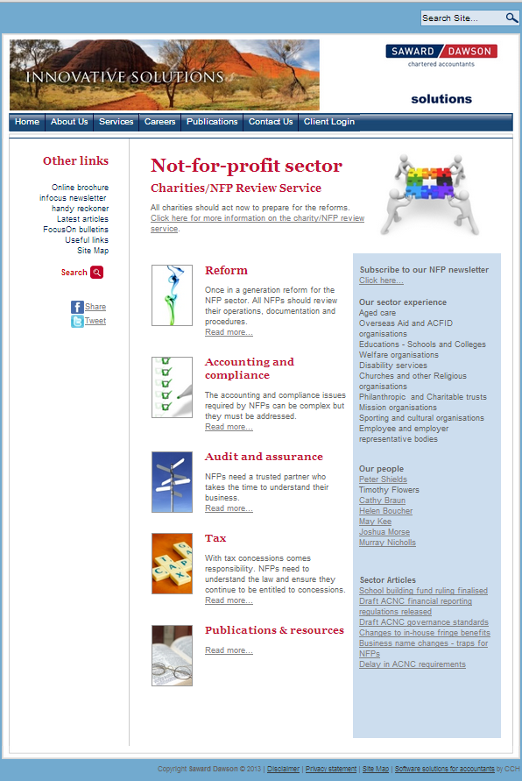

Slide 60
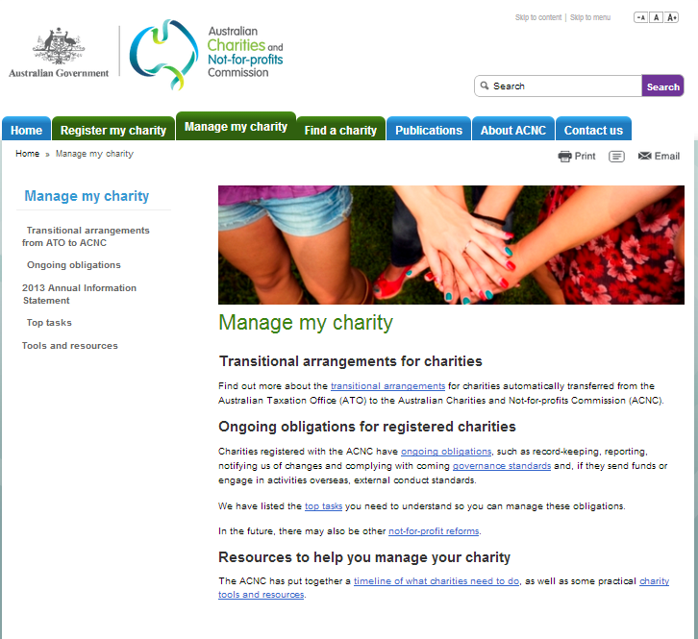

Slide 61

Questions...over to you

Slide 62
Disclaimer
Disclaimer
This presentation has been prepared by Saward Dawson for educational purposes for
presentation at our seminar. The contents are best understood in the context of the verbal
presentation that accompanied this presentation when delivered. We believe that the
contents are correct at the time of production however this presentation is not intended to
replace specific advice nor is it designed to be used in isolation of specific advice by an
appropriately skilled professional. Saward Dawson therefore does not accept any liability
(whether arising in contract, in tort or negligence or otherwise) for any error or omission in
this presentation or for any resulting loss or damage (whether direct, indirect, consequential
or otherwise) suffered by the recipient of this presentation or any other person.

